Slide 1
F1 Racer Efficiency
By: Troy Benner, Kiefer Jenny and Will Moore (Group 5)
Notes:
(Troy) Good Afternoon, My name is Troy, this is Kiefer and Will. Our data analysis project was on F1 Racer efficiency.

Slide 2
Use Case
Formula 1 World Championship (1950 - 2024)
Analyze individual driver’s performance or group results to get more insights
Enable professional F1 race analysts, enthusiasts, and sports bettors
Tables Used:
driver_standings
driversId
raceId
lap_times
pit_stops
qualifyingId
results
Rank F1 drivers → for actionable insights based on performance metrics
Ranking reflects their consistency, pit stop efficiency, risk taking tendencies, and team strategy
Notes:
(Troy) For our project, we were assigned the Formula 1 World Championship dataset that ranges from 1950 to 2024. Our task was to analyze individual driver performance and group the results to gain useful insights into the factors affecting racing. The goal is to enable F1 race analysts, enthusiasts, and potential sports bettors to make educated choices based on our data. To achieve this, we selected seven tables from the original dataset. driver standings, driversID, raceID, lap_times, Pit_stops, qualifying_ID and results. We then used this data to rank drivers based on several factors relevant to data analysis.

Slide 3
Relationship Rules
Too many relationships to list them all here
Important relationships:
Each driver will have zero to many pit stops, each pit stop belongs to one driver
Every race has many results, each result belongs to one race
Each driver has only one nationality, a nationality can belong to one or many drivers
Each race occurs at one location and time, one location and time belongs to one race
Every qualifying time belongs to one driver, a driver can have zero to many qualifying times throughout their career
Why “zero” to many?
Newly registered drivers, for example, can have zero races, pit stops, lap times, etc.
Notes:
(Will) We ended up with 10 tables
After noticing relationships in our OG database (LOCATION AND TIME) Keifer

Slide 4
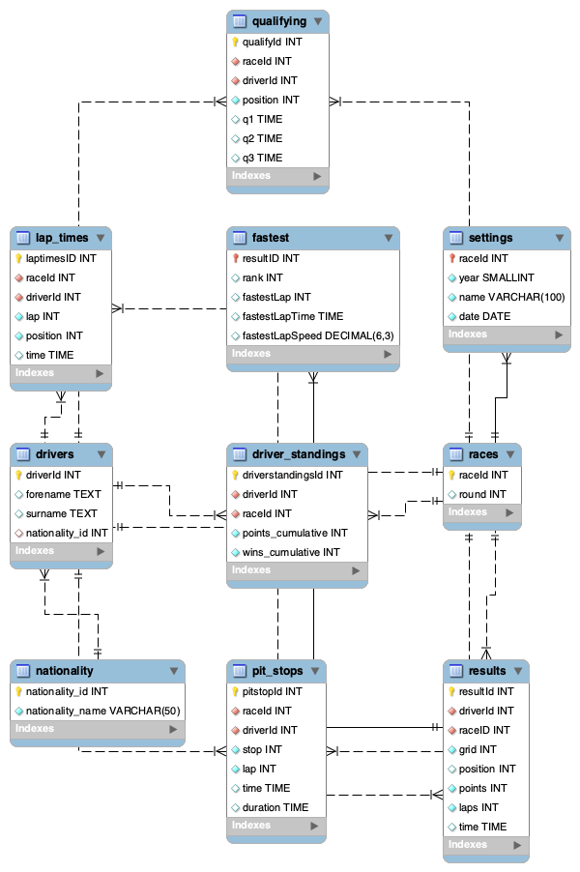
ERD Diagram
New tables were created to satisfy the third normal form requirements
settings
nationality
fastest
Connected to existing tables through primary and foreign keys
Notes:
(Kiefer)

Slide 5
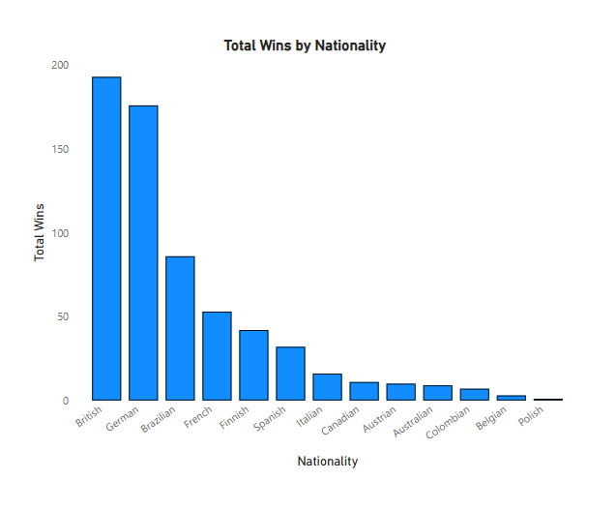
Key Findings 1
This graph showcases the number of First-Place finishes each country has ordered from highest to lowest
Britain and Germany are the best at F1, with Brazil and France behind
Countries not pictured do not have a win
Despite America’s size, population, and international sport prowess, they are not featured
Notes:
(Kiefer)

Slide 6
Key Findings 1 Continued
Sports Bettors and enthusiasts alike can use this data to inform their opinions
Bettors may favor the top performing countries when making decisions
Nations looking to join the upper ranks could look towards better performing countries as examples
The query used to create this view could be edited to showcase the years these wins happened, allowing for a more in depth look
Notes:
(Kiefer)

Slide 7
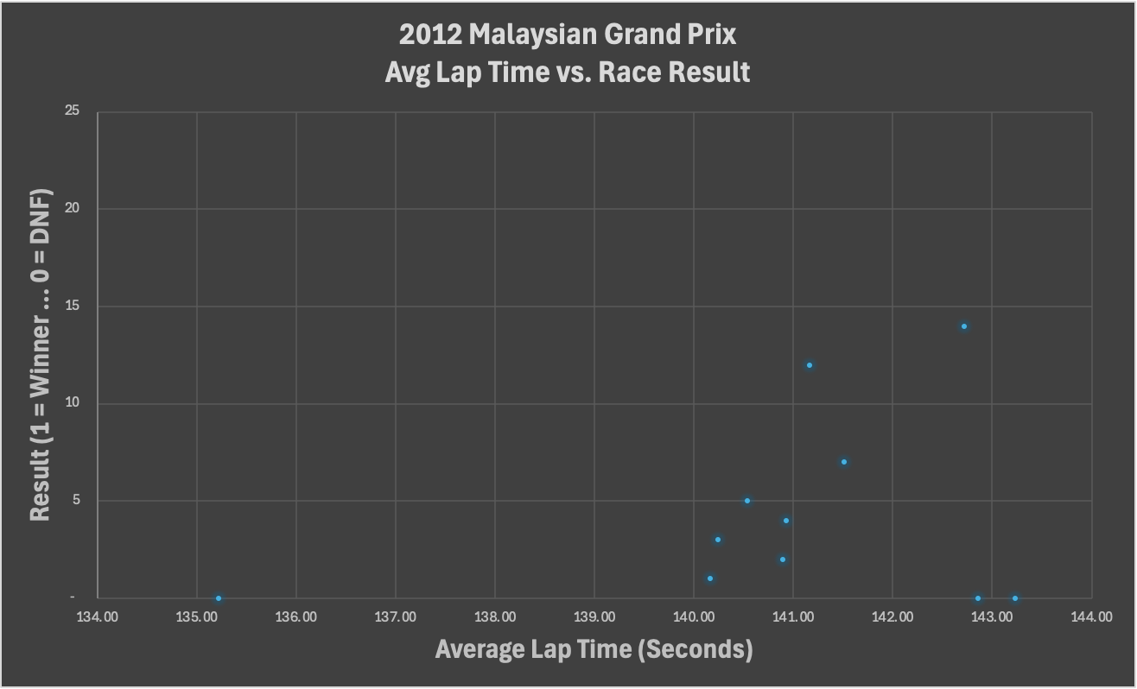
Key Findings 2
The scatter plot represents the drivers Average Lap Time vs which “Place” drivers crossed the finish line
The data points represent drivers
Fast Car - High Finish
0 place → Sometimes drivers crash, but other times, drivers have engine trouble and choose to slow down to preserve their engine
Notes:
(W) We were curious about How Many Seconds A Lap Takes On Average and How that affected Who WINS OR LOSES
This chart represents who drove fastest on average and what place the drivers ended up in with they crossed
Because Winning is not determined by who drives fastest - Is It REALLY good to be the FASTEST?

Slide 8
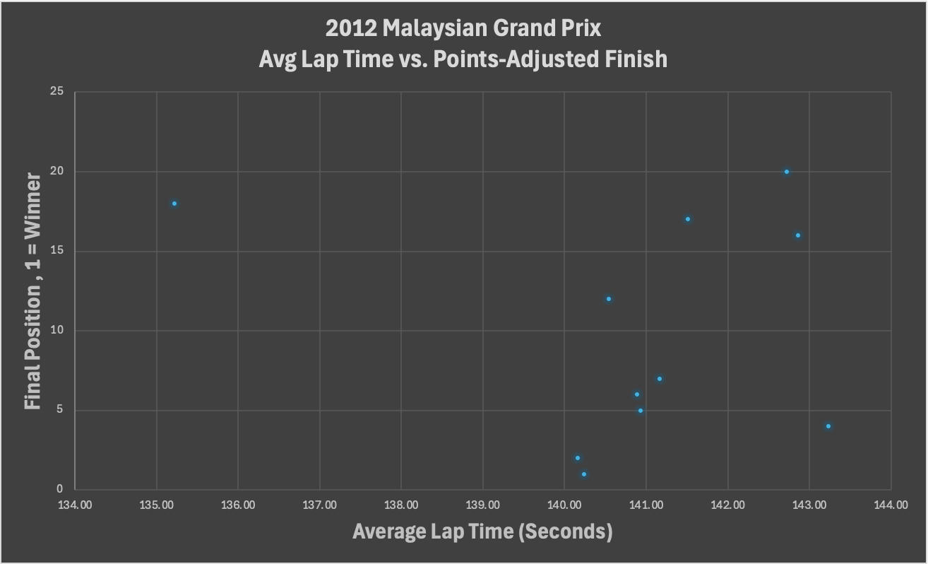
Key Findings 2 cntd.
These are the Points Adjusted Driver Standings
Some drivers shift many places as points are adjusted
Negative Trend is largely still in place - Suggesting it’s still good to finish fast instead of driving cautiously slow
Outliers that didn’t finish the race still get standings. One outlier in top 5, suggesting good strategy
Notes:
(W)
to Troy

Slide 9
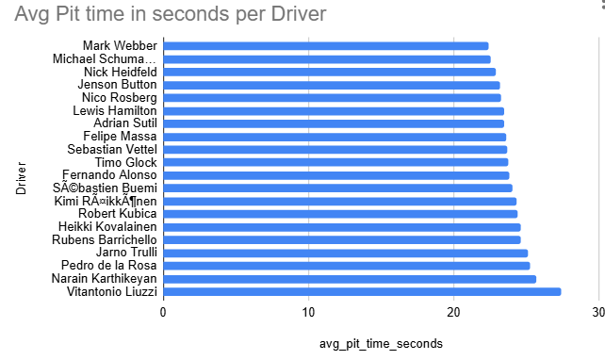
Key Findings 3
This graph provides insight into the top 20 average pit stop times for f1 racers with 5 or more stops recorded.
Mark Webber is shown with the lowest time spent during pit stops at 22.43 seconds average
In f1 every second counts, this information is vital for f1 teams.
(Lower time is better)
Notes:
(Troy) F1 races are a team sport, and every second is crucial. Drivers and their support staff must find every way possible to optimize the efficiency of every race aspect. One area F1 teams have nearly perfected is the pit stop. I am sure you have likely seen this example in pop culture: a racer pulls into a parallel spot, and a bunch of masked mechanics run out, replace the tires, and fill up the fuel, servicing the vehicle in as few as 2 seconds.
This graph provides insight into the top 20 average pit stop times by racers who have recorded five or more stops. This is the total time spent by each racer in the pit stop for the whole race. F1 races are pretty long, roughly around 90 minutes, so anywhere a team can control the amount of time saved is a crucial aspect that determines the winner.

Slide 10
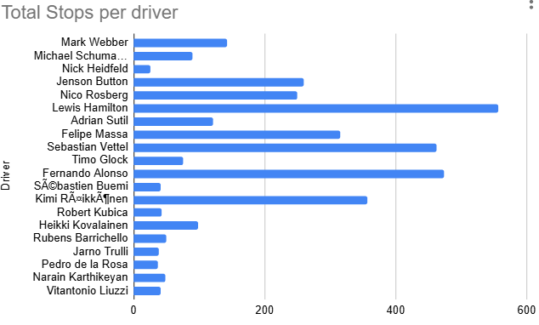
Key Findings 3 Continued
This graph shows the same top 20 drivers and the amount of recorded pit stops
Slight skew suggests that more experienced drivers tend to have better averages
Notable names of top drivers maintain sub 24 second averages with hundreds of stops
Notes:
(TROY) This graph complements the previous one. It expands on the same top 20 racers but includes the number of total stops that each has take over their careers (as recorded by the given data set). Racers can take as many pit stops as needed, but ultimately, the goal is to take as few as necessary to minimize time off task.
As you can see, there is a slight trend toward the best racers having the most experience taking pit stops. Of course, F1 is a chaotic sport, and many things can happen during a race that might skew the time one way or another, but in general, the more experienced the driver and the better the pit crew, the less time is spent in the pit stop. High-end pit crews and pit times generally correlate with wins. Racers like Lewis Hamilton have over 500 recorded pit stops and over 100 race wins. Yet this isn't always going to be the case, as there will be some racers who might not be the best on track but have an excellent pit crew to provide excellent times. Mark Webber, for example, won 9 Grand Prix races during his career, but he raced with Redbull, which is touted as one of, if not the best, pit crew in f1.
Bettors and enthusiasts alike can use this data to fine tune their expectations when it comes to pit stop time and efficiency. For example a mid range racer, racing for redbull or mclaren might earn a higher placement due to the pit crews efficiency.

Slide 11
Key Takeaways
F1 is a deeply European sport backed by wealth, industrialization and experience that's difficult to infiltrate
Every second counts, and many of the driver factors that can be optimized have been nearly perfected
Faster cars generally correlated with higher place finish
Faster lap times = higher placement finish
F1 is a team sport and the crew supporting the driver has a large impact on their individual placement
Notes:
(Troy) To conclude our research, we found that F1 as a whole is a deeply European sport backed by large amounts of wealth, long-established brands, and experienced leadership that's hard to infiltrate as a newcomer.
Every second in F1 counts, and many of the factors that can be optimized have been refined through years of trial and error. These include pit stops, racing lines, overtaking, drafting, and even vehicle construction. The faster the lap time and the faster the car, the better the placement. However, anomalies in the data are likely present due to a DNF caused by a mechanical failure or wreak.
Overall, F1 is a team sport, and the crew supporting the driver has a big impact on the driver's placement. F1 stats can be measured and their insights put to good use in many ways. Our findings have only scratched the surface of what you can explore in F1.

Slide 12
Questions?
Notes:
(Troy) Thank you for your attention are there any questions?
Name artifacts caused by SQL not recognizing characters. We could’ve potentially used TRANSLATE Command or REPLACE accented characters but due to the large variety of languages we would've needed to replace dozens of accented characters.

